Slide 1

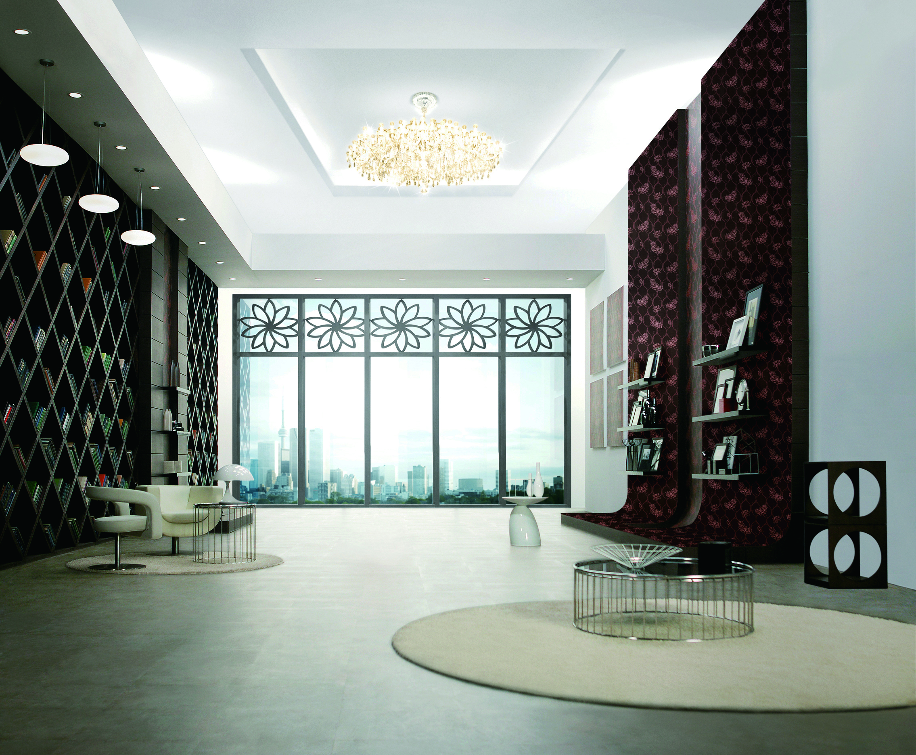
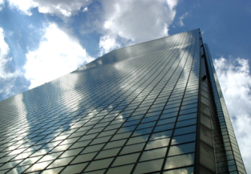
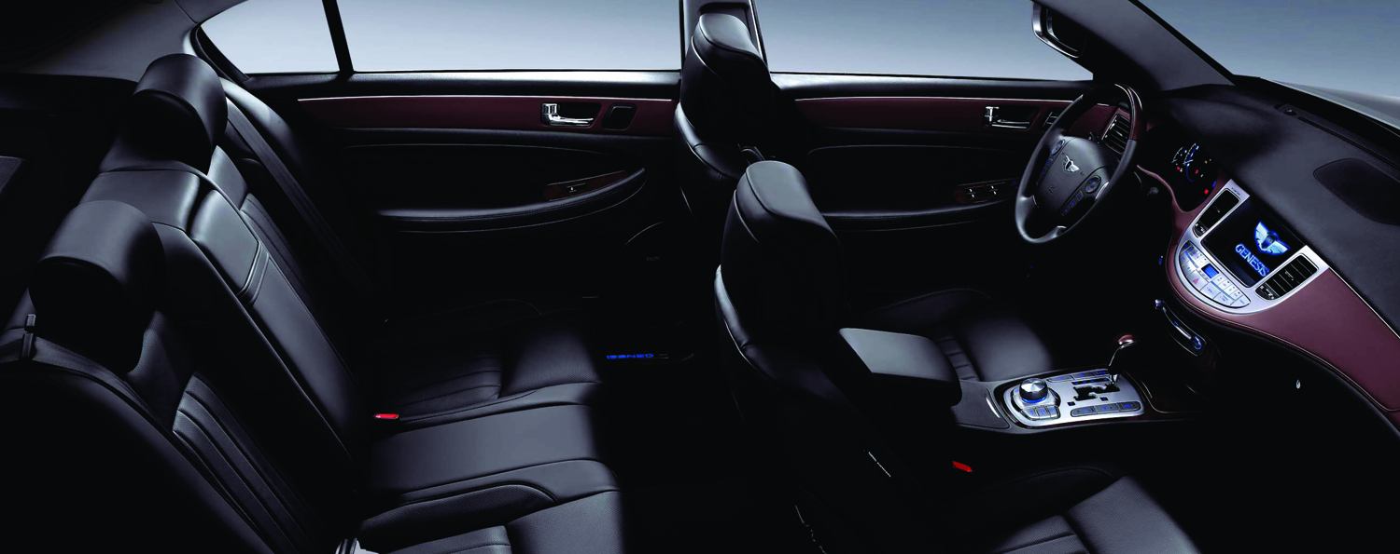
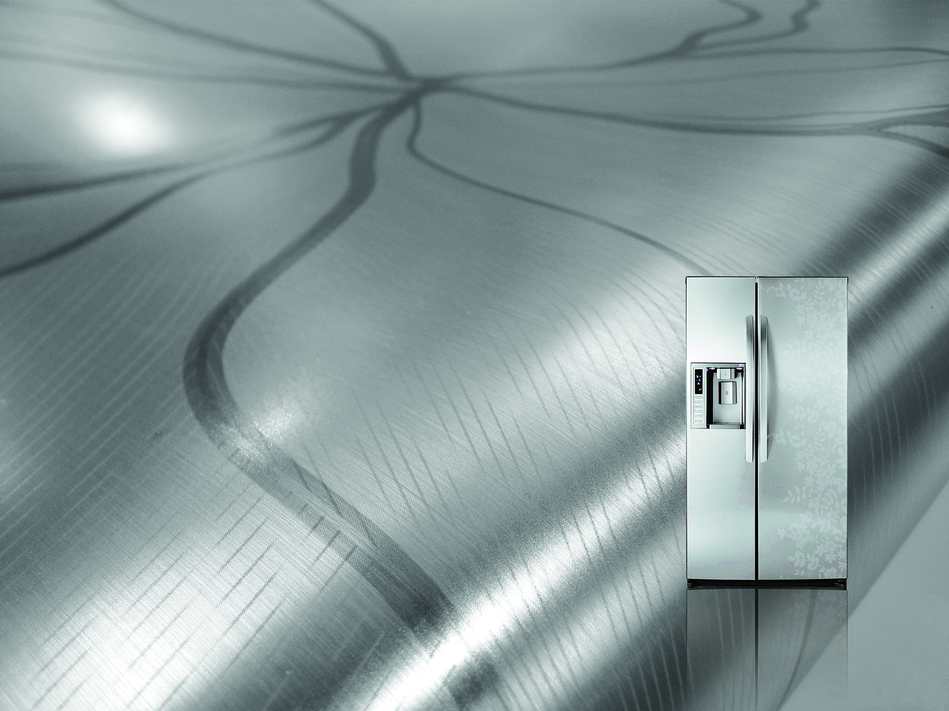

Business Domain
LG Hausys
Interior
materials
Windows
/Curtain walls
Automotive
Material
High Performance
Materials
Interior Film
Film Finishing Material
Pressure Sensitive Adhesive
Application
Vacuum Insulation Panel
Wood Polymer Composite
Sign & Graphic Materials
Surface Material
Wall covering
Flooring
Deco foil
•
Window
Curtain wall
Functional Glass
Automotive Part
Covering Materials
1
/31

Slide 2
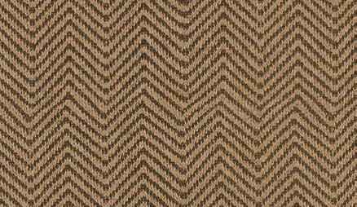
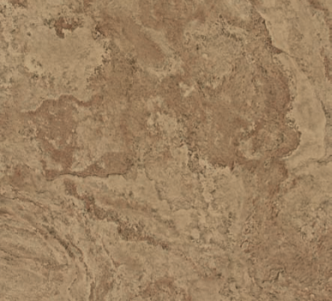
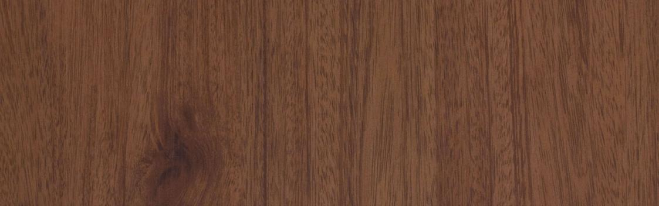

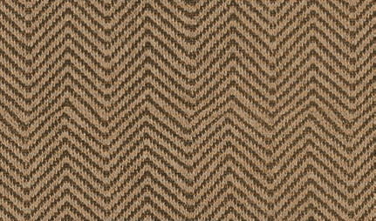
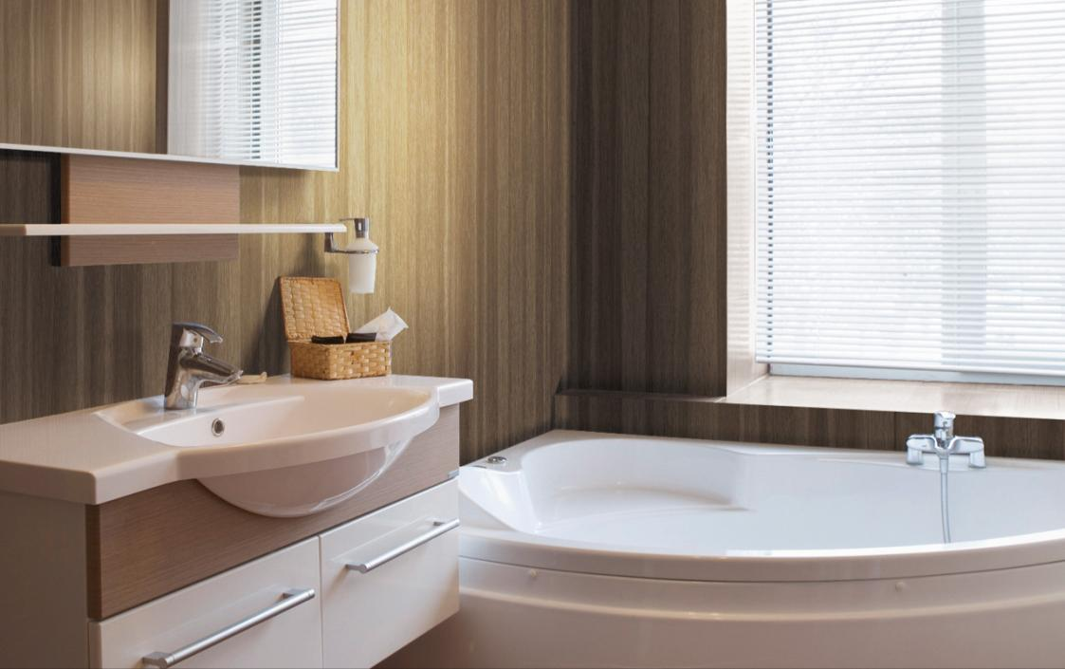
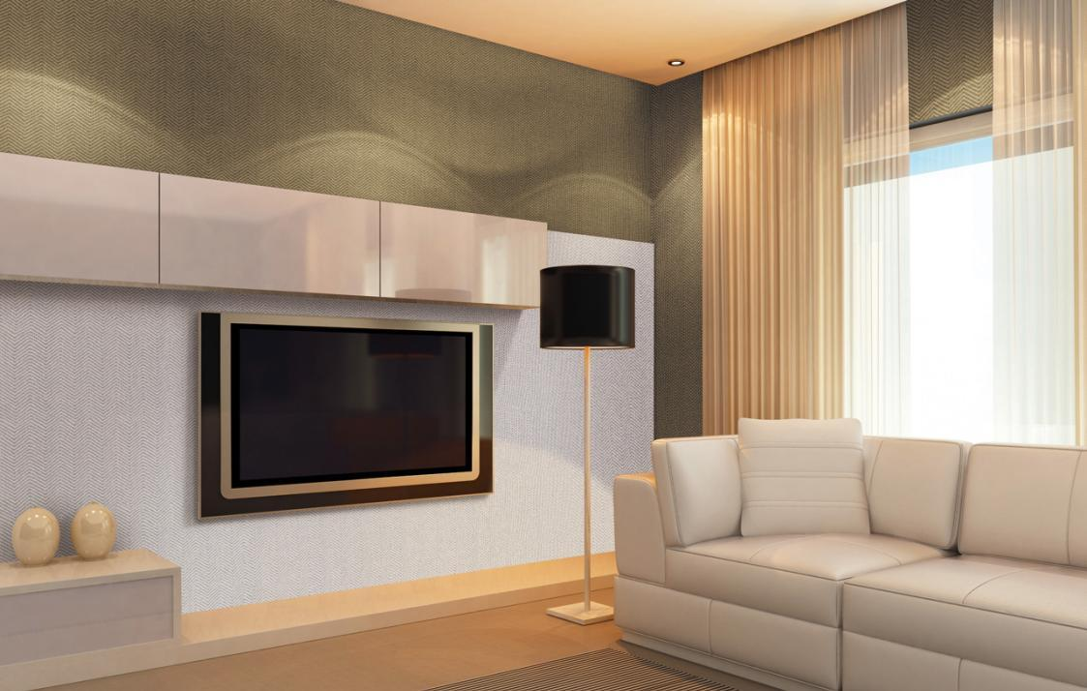
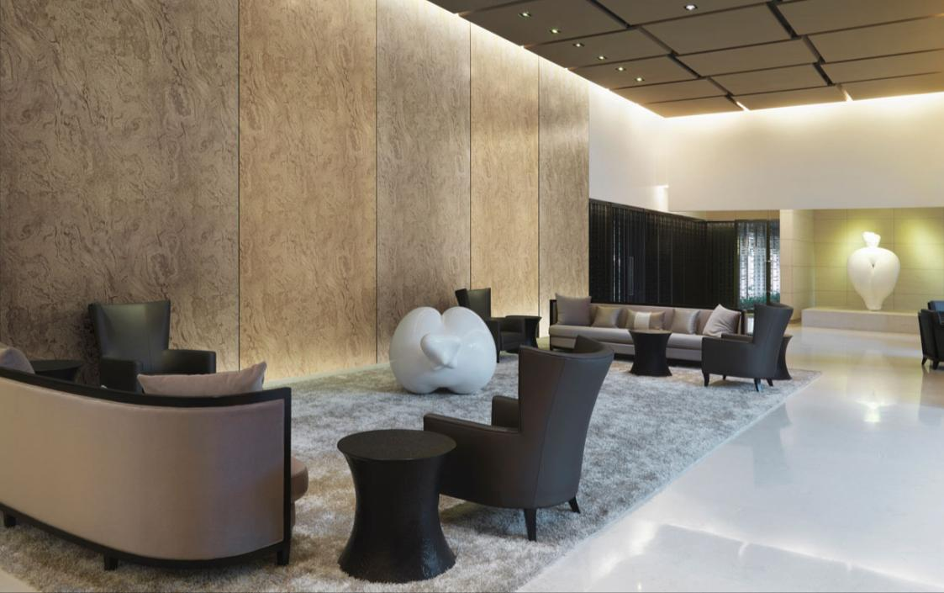
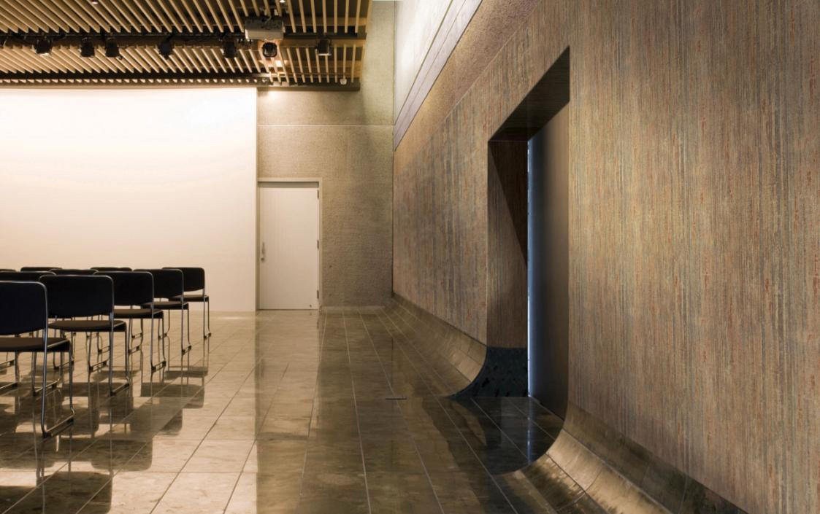
Interior Film
LG Hausys Interior Film is designed for flat lamination and profile wrapping.
With its special self-adhesive treatment, interior film is easy to apply not only on flat surface but also on irregular surface, saving time and cost.
Stone
Fabric
Wood
Metal
2
/31

Slide 3
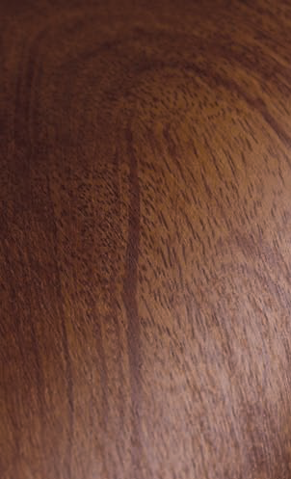
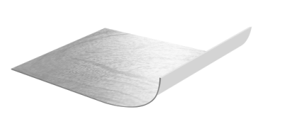
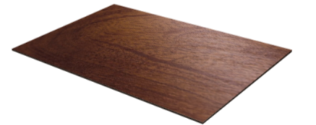

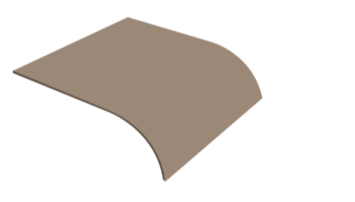
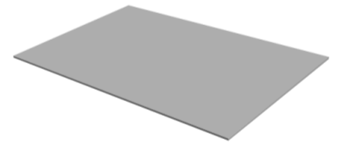

What is Interior Film
LG Hausys Interior film
LG Hausys Interior film
LG Hausys Interior Film is.
Protective film
Print Layer
Adhesive Layer
Release paper
Basic Structure

Slide 4
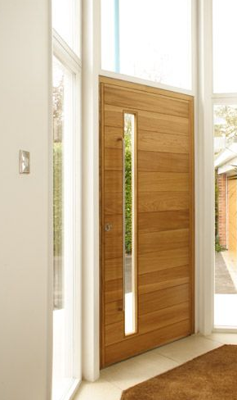
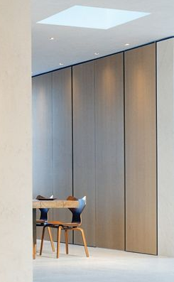
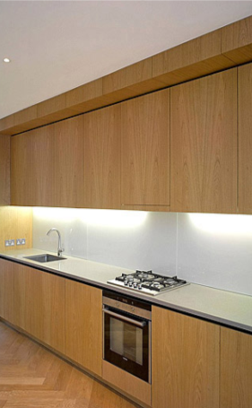
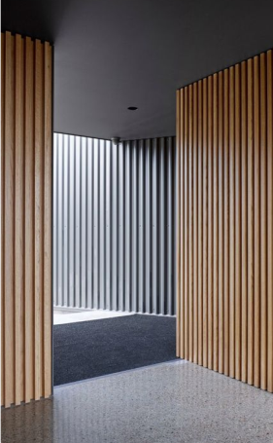
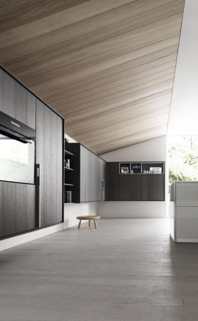
Explore new ideas for endless
possibility
LG Hausys Interior film
Furniture
Door
Wall
Ceiling
4
/31

Slide 5


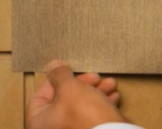

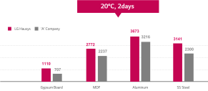



Essential Elements of
Interior Film
LG Hausys Interior film
Reliable Quality
Fire Resistance
Build Ability
Eco Friendly
very stable even when exposed to heat, humidity or low temperatures.
Fire Resistance Certification
England, Europe, China, Japan, America
Fire Resistance Certification
England, Europe, China, Japan, America
LG Hausys uses Heavy Metal free
and 100% phthalate free plasticizers.

Slide 6
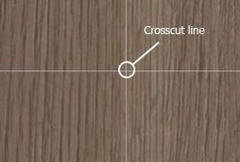
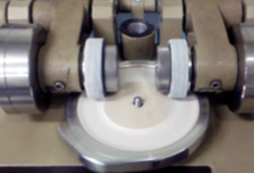
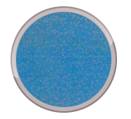
Quality specification
LG Hausys Interior film
Highly resistant to impact, abrasion and scratching.
Dimensional
Stability
Durability of
Abrasion
Antibiosis
Measure the gap
after 2days(65°C)
Test Standard
JIS K 7204
Test Standard
JIS Z 2801
Gap
within 0.3mm
After 5000cycle
No Change
Bacillus, Staphylococcus aurous
95% sterilizing effect
Notes:
LG Hausys Interior Film is also very stable even when exposed to heat, humidity or low temperatures.

Slide 7
Adhesiveness tensile strength
LG Hausys Interior film
Adhesiveness Test with 25mm*180mm film sample under experiment environment.
20°C, 2days
40°C, 95%, 30days
LG Hausys
‘A’ Company
3673
3216
3141
2772
3053
2237
2300
1742
1110
707
Gypsum Board
MDF
Aluminum
SS Steel
Unit : gf

Slide 8
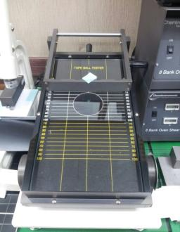
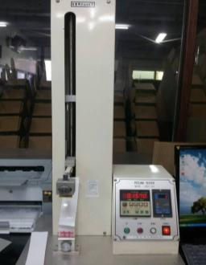
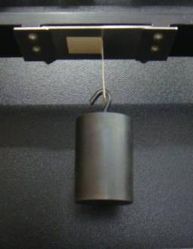
Reliable & Consistent quality
LG Hausys Interior film
Consistent Quality Control infra.
Ball Tack Test
Instron Test
Creep Test
1800g/in
rnaintain
20min
Ball
PSA
Steel plate
500g
Steel plate
All LG S&G products are manufactured to ISO 9001quality
procedures for systemsand processes
Notes:
reliable quality
①철저한 품질관리: QC전담팀, 있음.. 생산 설비 무진룸, cesco 완비 /다양한 품질 테스트 장비현황
② 다양한 인증서 보유 (ISO, ROHS, anti-slip, R9, 난연,,등)
③ warranty: LG하우시스는 제품 품질에 자신있게 책임을 진다. 당사 제품하자에 대해서는 책임지고 보상,
워렌티, 호주워렌티 레터, 팝업정도,,,)

Slide 9













Fire Resistance Certification
LG Hausys Interior film
England
Europe
不燃
America
China
Japan
Korea
不燃
UL
(America)
不燃
(Japan)
KR
(Korea Shipping)
Lloyd
(England Shipping)
KFI
(Korea)
A2
(China)
CE
(Europe)
Notes:
선박/ 호텔

Slide 10


Non Phthalate & Heavy Metal Free
LG Hausys Interior film
LG Hausys uses Heavy Metal free and 100% phthalate free plasticizers.
Hazardous Chemical
Phthalate Restriction
restriction
all products
Europe
Phthalate
Phthalate
Endocrine
disruptor
Asia
Kids products
(under 14)
USA
Baby products
(under 3)
Hormone
system
disorder
Developmental disorders
Birth defects
Cancerous tumors
Potential
risks
~’07
’08
’09
’10~

Slide 11


Non Phthalate & Heavy Metal Free
LG Hausys Interior film
LG Hausys uses Heavy Metal free and 100% phthalate free plasticizers.
Heavy
metals
Form-
aldehyde
Volatile
organic
compounds
Phthalate
Toluene
Non
Phthalate
Below
standard
Below
standard
Below
standard
Below
standard
Below 0.5mg
/kg
Below 0.015mg
/m2.h
Below 0.4mg
/m2.h
Below 0.080mg
/m2.h

Slide 12
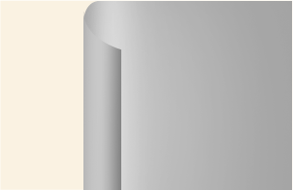
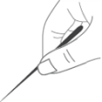






Build Ability
LG Hausys Interior film
No more Air-bubbles during installation
1
LG Hausys
Independent removal workfor the bubble removal
2
In Air Free air bubbles escape easily
Shortening construction time
It takes the complaint and time associated with the bubble removal

Slide 13
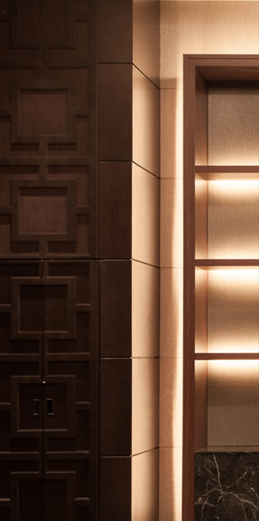
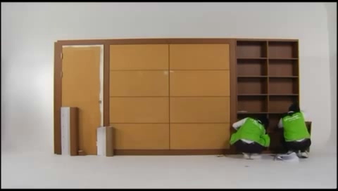
Build Ability
LG Hausys Interior film
Easy Application

Slide 14
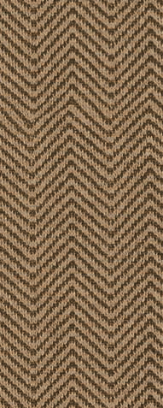
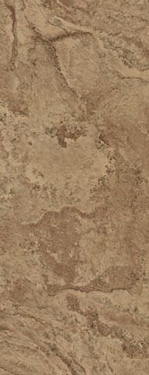
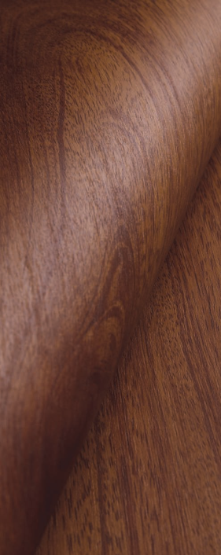

Fabric
Stone
Wood
Metal
14
/31

Slide 15

Design Excellence

Slide 16

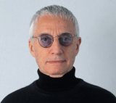



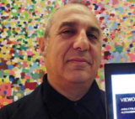





Design Excellence
LG Hausys Design Center
LG Hausys attended various global awards ceremony including Red dot, IF, Materiallica, Material vision.
Design Center
Designer Collaboration
106
designers
Alexandro Mendini
Zaha Hadid
Marcel Wanders
45 times
top three design awards
45 times
top three design awards
Stefano Giovannoni
Karim Rashid
Vera Wang
Notes:
Our design center has around 100 designers.
They are sharpening our design competencies, evidence of which is found
in the many global design awards including Red Dot and iF design award.
Also we collaborate with world famous designer to release trend leading design every year.

Slide 17
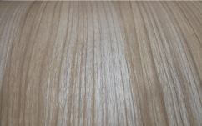
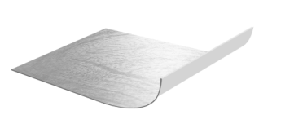



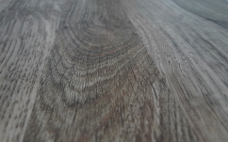

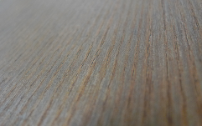
Various Effect of surface
Design Excellence
Coating techniques for true natural wood texture
General
Coating
Matt /
Glossy Coating
Finish Coat
Deep Emboss
Coating

Slide 18
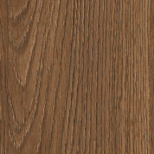
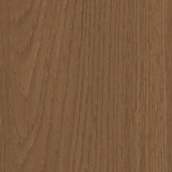
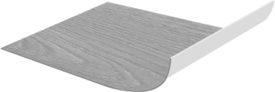
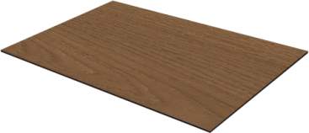
Emboss Technology
Design Excellence
Coating techniques for true natural wood texture
Produce a feeling of vivid living grain
Deep Emboss
Real Wood Print
Surface feel realistic touch of the largest timber
Base Film

Slide 19


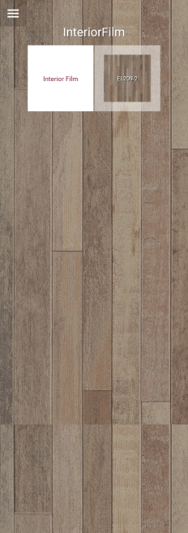
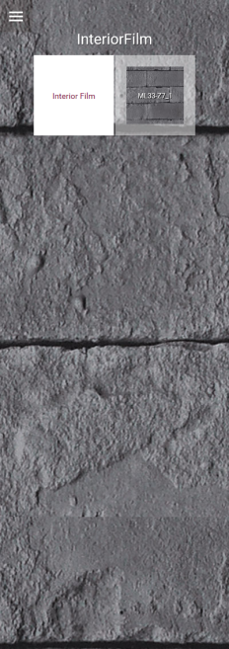
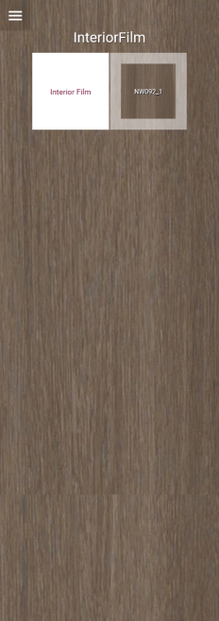








www.lghausys.com

Slide 20


Conrad Seoul, Korea
Enforcement design by Eunmin, Film installation by Jungsan, Color : NW008
Notes:
Conrad seoul In korea, Wood columns are covered with LG Hausys interior films

Slide 21


Conrad Seoul, Korea
Enforcement design by Eunmin, Film installation by Jungsan, Color : NW008
Notes:
Some part of interior, including furniture and doors, finished with our product

Slide 22



Incheon Airport, Korea
Notes:
If you come to korea, you will see our product in Incheon airport at first. These grayish wood panel are LG Hausys interior film.

Slide 23

U Plus Cafeteria, Korea
Interior design by Kesson, Film installation by Markpro
Notes:
Ceiling decorative panels are covered with interior films

Slide 24

U-Plus, Korea
Interior design by Kesson, Film installation by Markpro, Color : NW006
Notes:
Wall
현장 : LG유플러스 용산 사옥
시공인테리어사 : 계선
대리점 : 마크프로
제품명 : NW006
l finish

Slide 25

MERITZ Tower, Korea
Notes:
Ceiling finish

Slide 26

LG Hausys HQ, Korea

Slide 27

LG Hausys HQ, Korea

Slide 28

U Plus HQ, Korea

Slide 29

U Plus HQ, Korea

Slide 30

U Plus HQ, Korea

Slide 32



페이지 번호 편집하기
1
파워포인트 상단
[보기]-[슬라이드 마스터] 선택
2
마스터마다 오른쪽 하단
번호를 입력
3
[마스터보기닫기] 를 선택하여
원상태로 복구

